Slide 1

BOOT CAMP- FIRST YEAR
School of Computer Science & Engineering (SOCSE)
“Technical Writing”
2-Credit Course, Workshop Mode

Slide 2
Technical Writing
Student Workbook
This is a copyright of Dr Phani Kumar Pullela, Professor, RV University. Any one from industry/ academic are FREE to use this content for training and research purpose, without any restrictions. If used for realizing a review paper, kindly acknowledge RV University, Bengaluru in your publications!

Slide 3
Step1: Kindly select Topic, Subtopics, Field, Domain, Area https://docs.google.com/spreadsheets/d/1BBV-bJeTcjyN9VWNhG8NE2IIb9mdtwx_/edit?usp=sharing&ouid=113711538485661525669&rtpof=true&sd=true
Topic/ Tentative Title | Survey guidelines in software engineering An annotated review.
Field | Computer Applications
Domain | Software Engineering
Area | Annotation Title
Subtopic 1 | Introduction
Subtopic 2 | Prior Art
Subtopic 3 | Theory
Subtopic 4 | Current Status
Subtopic 5 | Future Scope

Slide 4
Title of the paper & affiliation
Title of the paper (Write Topic) | Survey guidelines in software engineering an annotated review
Student name (Write Your name) | Alisha Taj
Faculty name | Phani Kumar Pullela
University Affiliation | School of Computer Science Engineering (SOCSE), RV University, RV Vidyanikethan Post, 8th Mile, Mysuru Road, Bengaluru – 560059
Keywords (Write Field, Domain, area, 2 important keywords from topic) | Computer Applications , Software engineering , Annotated pipe line , Survey Guidelines , Annotated review.

Slide 5
Step 2: Important sentences from “Field + Topic” from Google Search
Literature sentences (5 sentences) | Rewritten sentences from the student (4-5 sentences)
- The basic idea of survey methodology is to collect information from a group of people by sampling individuals from a large population. - Software engineering research is multi-disciplinary and a survey in this area, of course, resembles surveys in other areas when it comes to the methodology. - Based on the research questions the target population and the audience of the study can be defined. - When the sample population has answered the questions in the instrument the researcher can analyze the data, and draw conclusions based on the analysis. - Methodology relies on sampling, - a “fixed design” according to Robson

Slide 6
Step 3: Important sentences from “Domain + Topic” from Google Search
Literature sentences (5 sentences) | Rewritten sentences from the student (4-5 sentences)
-Survey is a method of research aiming to gather data from a large population of interest. -Despite being extensively used in software engineering, survey-based research faces several challenges. -Survey-based research in software engineering has its particular challenges, as illustrated by several articles in this review. -The annotated review can contribute by raising awareness of such challenges and present the proper recommendations to overcome them. -Survey is a method of research aiming to gather data from a large population of interest. Despite being extensively used in software engineering, survey-based research faces several challenges, such as selecting a representative population sample and designing the data collection instruments.

Slide 7
Step 4: Important sentences from “Area + Topic” from Google Search
Literature sentences (5 sentences) | Rewritten sentences from the student (4-5 sentences)
-Software Engineering research diﬀers from other disciplines , in particular regarding its objectives and subjects. -Survey-based research has been used to capture opinions in diﬀerent research disciplines. -In Software Engineering (SE), surveys are one of the most frequently used research methods for conducting empirical investigation studies. -The main objective of this study is to summarize and detail useful references supporting survey-based research in SE. - Methodological books provide valuable support to academics conducting empirical research. -The subjects of such studies usually involve well-qualiﬁed professionals with strong opinions regarding their areas of interest.

Slide 8
Step 5: Important sentences from “Topic” from Google Search
Literature sentences (5 sentences) | Rewritten sentences from the student (4-5 sentences)
-Papers retrieved by snowballing did not include all the references from the candidate articles, rather a contextual reading of the included papers and relevant citations were collected. -A pilot of the data extraction phase was done to validate the extraction form. -The main aim of the survey is to generalize the findings. Aims: In this study, we aim to identify the problems researchers face during survey design and mitigation strategies. -The elicited problems and strategies may serve researchers during the design of their studies. -A literature review, as well as semi-structured interviews with nine software engineering researchers, were conducted to elicit their views on problems and mitigation strategies. The researchers are all focused on empirical software engineering.

Slide 9
10% of your original review article is complete
Good job, keep going
Assignment 1 is complete

Slide 10

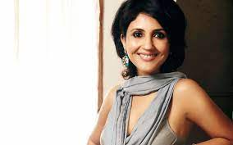
STORY 4
ANUJA CHAUHAN
I never took criticism seriously!
5 MIN

Slide 11
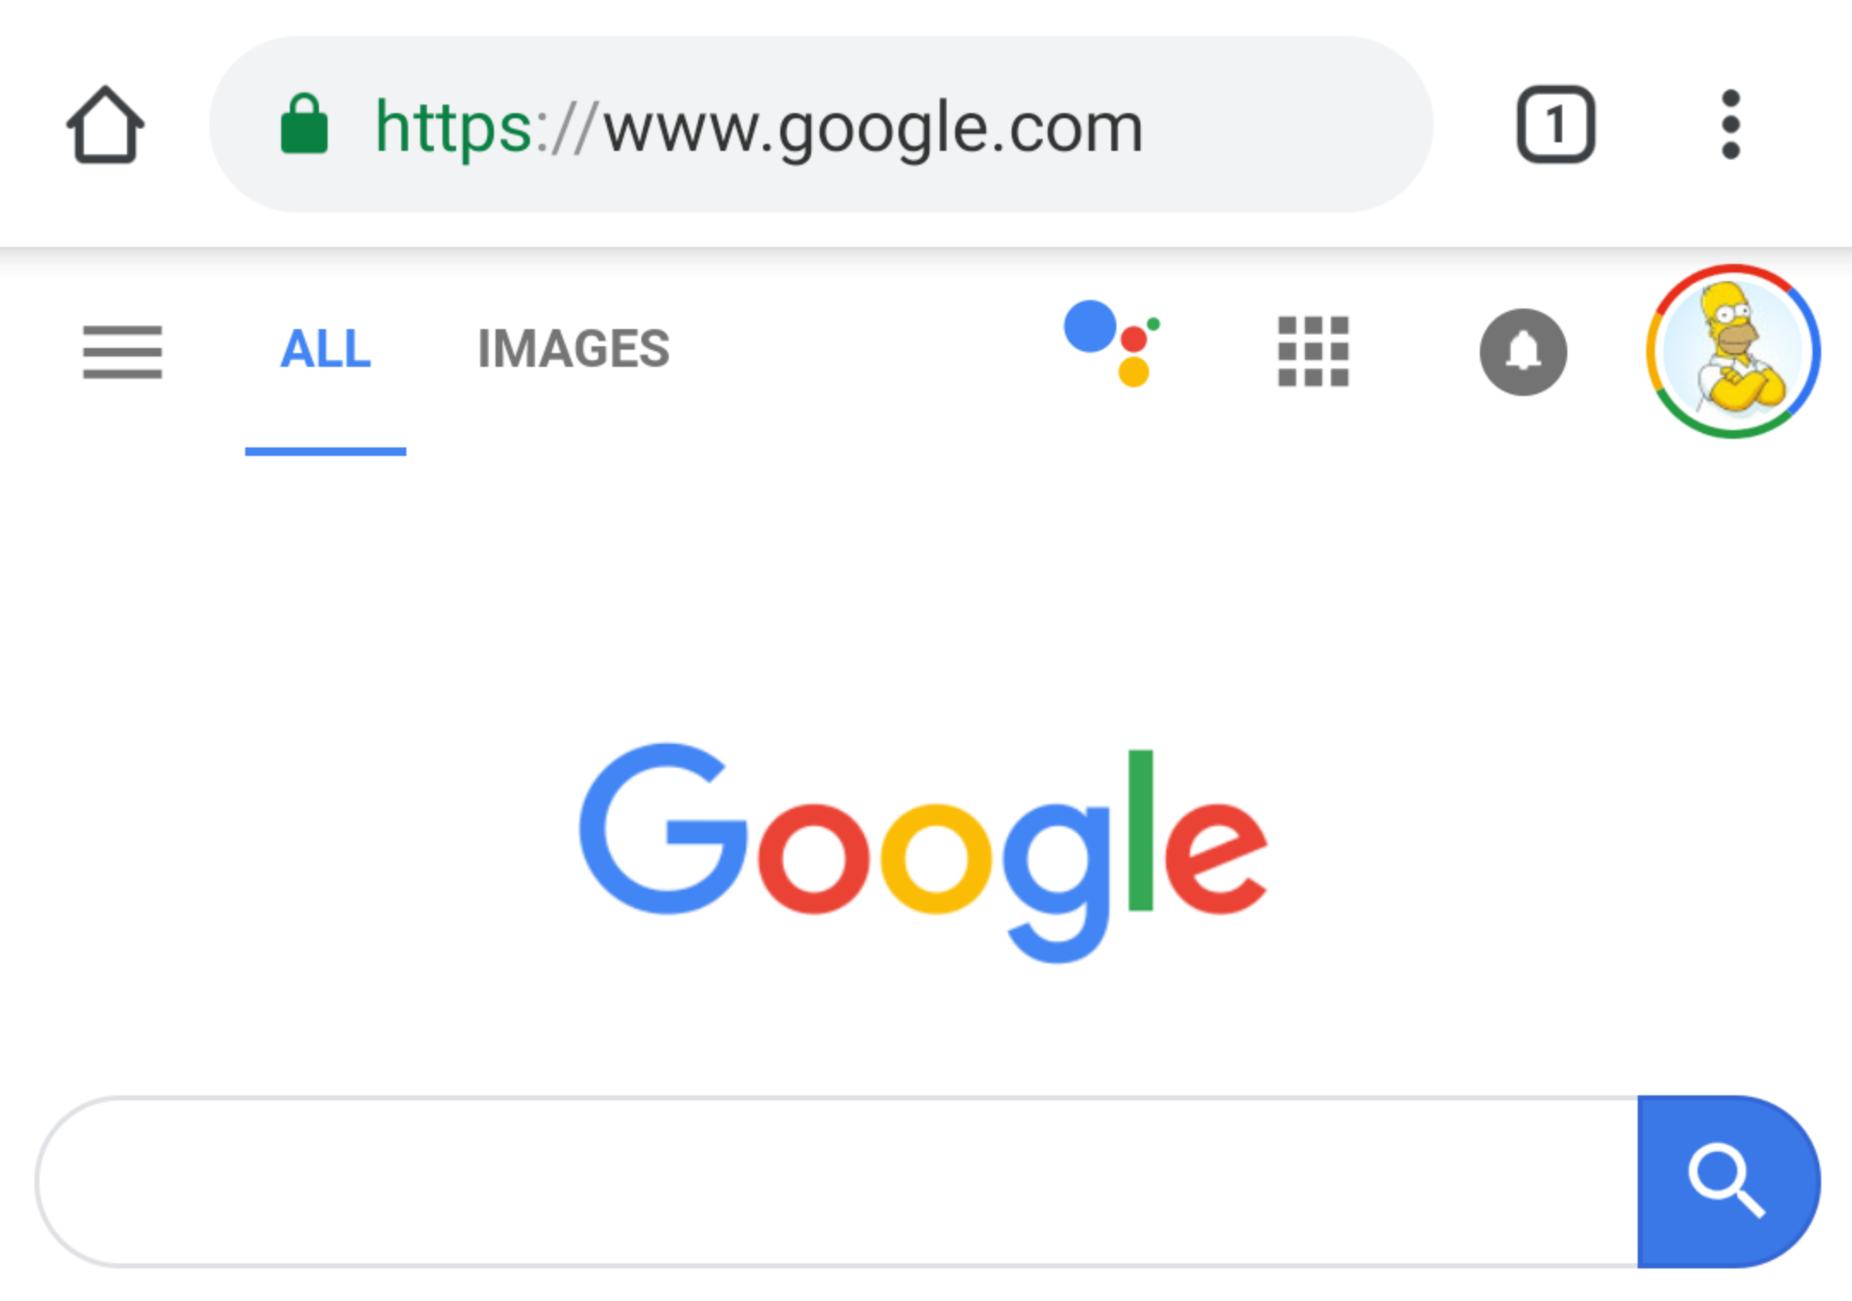
Searching for image
Type topic/ title in www.google.com
5 MIN

Slide 12
Step 6: Type “Topic” in Google Search, Look at Images (minimum 3-5), Understand and Create our own Smart art graphic (Figure 1)
Representative Image from Google search
Redrawn by Student

Slide 13
Step 7: Write Figure 1 Legend & Figure 1 Explanation
Figure 1 Legend (It is a one line explanation of what figure represents)
Figure 1 Explanation (Explain the figure in your own words, avoid using words like I, WE, YOU, THEY, THEM), -stick to third person language, active voice, present tense
Figure 1: Write “topic”

Slide 14
Step 8: Type “Topic + Subtopic1” in Google Search, Look at Images (minimum 3-5 ), Understand and Create our own Smart art graphic (Figure 2)
Representative Image from Google search
Redrawn by Student

Slide 15
Step 9: Write Figure 2 Legend & Figure 2 Explanation
Figure 2 Legend (It is a one line explanation of what figure represents)
Figure 2 Explanation (Explain the figure in your own words, avoid using words like I, WE, YOU, THEY, THEM), -stick to third person language, active voice, present tense
Figure 2: Write “Subtopic1”

Slide 16
Step 10: Type “Topic + Subtopic2” in Google Search, Look at Images (minimum 3-5 ), Understand and Create our own Smart art graphic (Figure 3)
Representative Image from Google search
Redrawn by Student

Slide 17
Step 11: Write Figure 3 Legend & Figure 3 Explanation
Figure 3 Legend (It is a one line explanation of what figure represents)
Figure 3 Explanation (Explain the figure in your own words, avoid using words like I, WE, YOU, THEY, THEM), -stick to third person language, active voice, present tense
Figure 3: Write “Subtopic2”

Slide 18
Step 12: Type “Topic + Subtopic3” in Google Search, Look at Images (minimum 3-5 ), Understand and Create our own Smart art graphic (Figure 4)
Representative Image from Google search
Redrawn by Student

Slide 19
Step 13: Write Figure 4 Legend & Figure 4 Explanation
Figure 4 Legend (It is a one line explanation of what figure represents)
Figure 4 Explanation (Explain the figure in your own words, avoid using words like I, WE, YOU, THEY, THEM), -stick to third person language, active voice, present tense
Figure 4: Write “Subtopic3”

Slide 20
Step 14: Type “Topic + Subtopic4” in Google Search, Look at Images (minimum 3-5) and Create our own Smart art graphic (Figure 5)
Representative Image from Google search
Redrawn by Student

Slide 21
Step 15: Write Figure 5 Legend & Figure 5 Explanation
Figure 5 Legend (It is a one line explanation of what figure represents)
Figure 5 Explanation (Explain the figure in your own words, avoid using words like I, WE, YOU, THEY, THEM), -stick to third person language, active voice, present tense
Figure 5: Write “Subtopic4”

Slide 22
Step 16: Type “Topic + Subtopic5” in Google Search, Look at Images (minimum 3-5) and Create our own Smart art graphic (Figure 6)
Representative Image from Google search
Redrawn by Student

Slide 23
Step 17: Write Figure 6 Legend & Figure 6 Explanation
Figure 6 Legend (It is a one line explanation of what figure represents)
Figure 6 Explanation (Explain the figure in your own words, avoid using words like I, WE, YOU, THEY, THEM), -stick to third person language, active voice, present tense
Figure 6: Write “Subtopic5”

Slide 24
25% of your original review article is complete
Very good, really impressed, keep going
Assignment 2 is complete

Slide 25
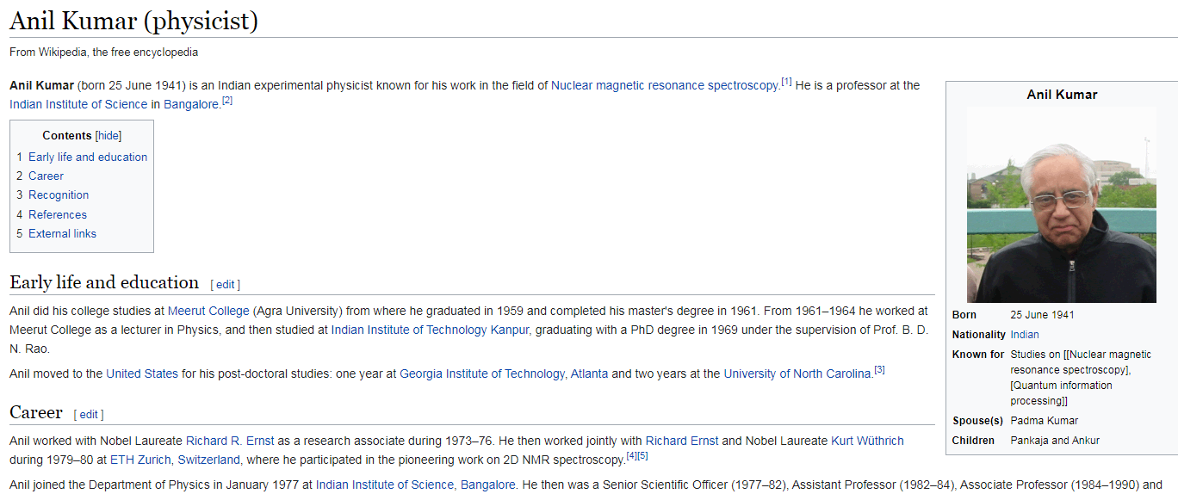
STORY 5: PROF ANIL KUMAR & DISCOVERY OF 2D NMR
Learn to do things for your satisfaction, not to impress others!
5 MIN

Slide 26

Google scholar
https://scholar.google.com/
2 MIN

Slide 27
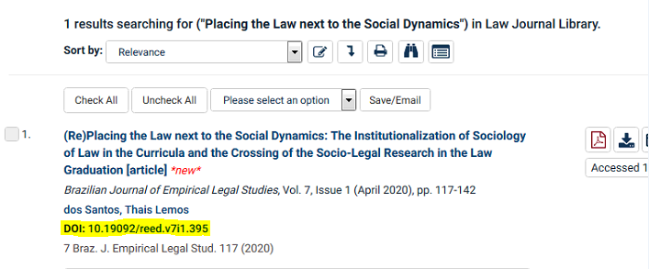
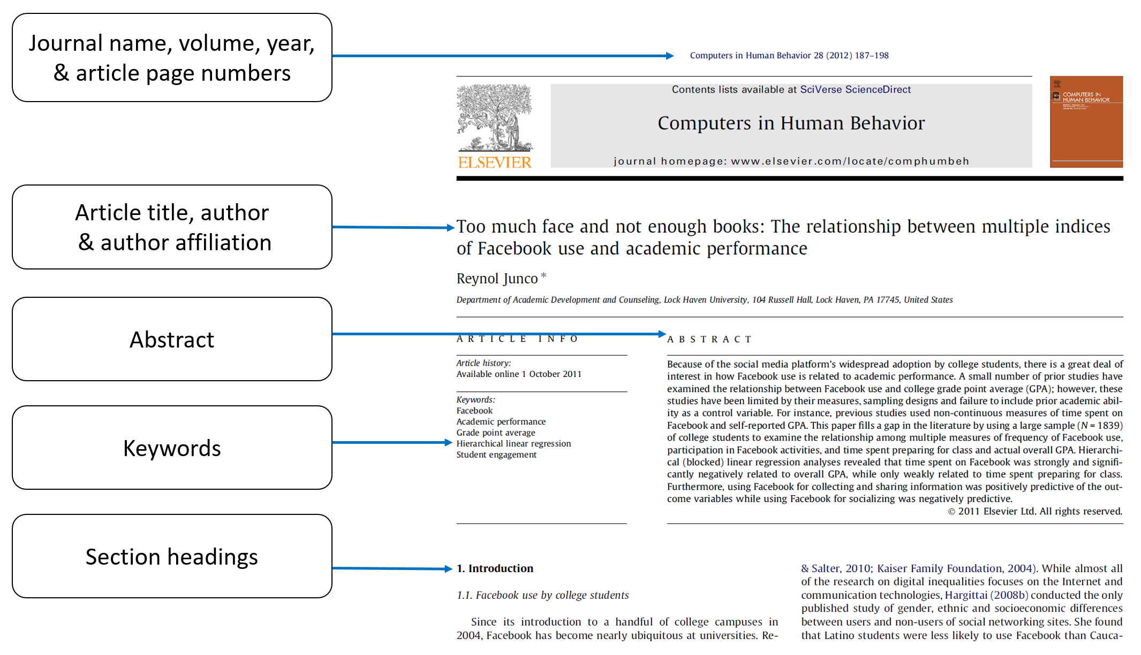
6 MIN

Slide 28
Subtopic 1.1: Type topic & subtopic 1 in Google Scholar, identify papers from reputed publishers and having high citations (> 10)
Title of the paper | Guidelines for conducting systematic mapping studies in software engineering: An update
Authors | Kai Petersen, Sairam Vakkalanka, Ludwik Kuzniarz
Journal Name | Information and Software Technology
Year | 2015
Volume (issue) | 64
Page numbers (XXX-YYY) | 1-18
Document identification Number (DOI), paste complete link | https://doi.org/10.1016/j.infsof.2015.03.007.
Identified important sentences from the abstract (minimum 4-5) | Systematic mapping studies are used to structure a research area, while systematic reviews are focused on gathering and synthesizing evidence. The most recent guidelines for systematic mapping are from 2008. Since that time, many suggestions have been made of how to improve systematic literature reviews (SLRs). There is a need to evaluate how researchers conduct the process of systematic mapping and identify how the guidelines should be updated based on the lessons learned from the existing systematic maps and SLR guidelines.
Rewrite the above sentences in your own words (minimum 4-5), avoid using words like I, WE, YOU, THEY, THEM), -stick to third person language, active voice, present tense

Slide 29
Subtopic 1.2: Type topic & subtopic 1 in Google Scholar, identify papers from reputed publishers and having high citations (> 10)
Title of the paper | Sampling in software engineering research: a critical review and guidelines
Authors | Baltes, Sebastian
Journal Name | Empirical Software Engineering
Year | 2022
Volume (issue) | 27
Page numbers (XXX-YYY) | 1573-7616
Document identification Number (DOI), paste complete link | https://doi.org/10.1007/s10664-021-10072-8
Identified important sentences from the abstract (minimum 4-5) | Representative sampling appears rare in empirical software engineering research. Not all studies need representative samples, but a general lack of representative sampling undermines a scientific field. This article therefore reports a critical review of the state of sampling in recent, high-quality software engineering research. The key findings are: (1) random sampling is rare; (2) sophisticated sampling strategies are very rare; (3) sampling, representativeness and randomness often appear misunderstood. These findings suggest that software engineering research has a generalizability crisis. To address these problems, this paper synthesizes existing knowledge of sampling into a succinct primer and proposes extensive guidelines for improving the conduct, presentation and evaluation of sampling in software engineering research. It is further recommended that while researchers should strive for more representative samples, disparaging non-probability sampling is generally capricious and particularly misguided for predominately qualitative research.
Rewrite the above sentences in your own words (minimum 4-5), avoid using words like I, WE, YOU, THEY, THEM), -stick to third person language, active voice, present tense

Slide 30
Subtopic 1.3: Type topic & subtopic 1 in Google Scholar, identify papers from reputed publishers and having high citations (> 10)
Title of the paper | A systematic review of systematic review process research in software engineering
Authors | Barbara Kitchenham, Pearl Brereton
Journal Name | Information and Software Technology
Year | 2013
Volume (issue) | 55
Page numbers (XXX-YYY) | 2049-2075
Document identification Number (DOI), paste complete link | https://doi.org/10.1016/j.infsof.2013.07.010
Identified important sentences from the abstract (minimum 4-5) | Many researchers adopting systematic reviews (SRs) have also published papers discussing problems with the SR methodology and suggestions for improving it. Since guidelines for SRs in software engineering (SE) were last updated in 2007, we believe it is time to investigate whether the guidelines need to be amended in the light of recent research. Textual analysis tools are likely to be useful for inclusion/exclusion decisions and search string construction but require more stringent evaluation. SE researchers would benefit from tools to manage the SR process but existing tools need independent validation. Quality assessment of studies using a variety of empirical methods remains a major problem.
Rewrite the above sentences in your own words (minimum 4-5), avoid using words like I, WE, YOU, THEY, THEM), -stick to third person language, active voice, present tense

Slide 31
Subtopic 1.4: Type topic & subtopic 1 in Google Scholar, identify papers from reputed publishers and having high citations (> 10)
Title of the paper | Lessons from applying the systematic literature review process within the software engineering domain
Authors | Pearl Brereton, Barbara A. Kitchenham, David Budgen, Mark Turner, Mohamed Khalil
Journal Name | Journal of Systems and Software
Year | 2007
Volume (issue) | 80 , Issue 4
Page numbers (XXX-YYY) | 571-583
Document identification Number (DOI), paste complete link | https://doi.org/10.1016/j.jss.2006.07.009.
Identified important sentences from the abstract (minimum 4-5) | A consequence of the growing number of empirical studies in software engineering is the need to adopt systematic approaches to assessing and aggregating research outcomes in order to provide a balanced and objective summary of research evidence for a particular topic. the paper reports experiences with applying one such approach, the practice of systematic literature review, to the published studies relevant to topics within the software engineering domain. The basic systematic literature review process seems appropriate to software engineering and the preparation and validation of a review protocol in advance of a review activity is especially valuable. The data extraction process is being conducted using a standardised electronic data recording form.
Rewrite the above sentences in your own words (minimum 4-5), avoid using words like I, WE, YOU, THEY, THEM), -stick to third person language, active voice, present tense

Slide 32
Subtopic 1.5: Type topic & subtopic 1 in Google Scholar, identify papers from reputed publishers and having high citations (> 10)
Title of the paper | Systematic literature reviews in software engineering – A systematic literature review
Authors | Barbara Kitchenham, O. Pearl Brereton, David Budgen, Mark Turner, John Bailey, Stephen Linkman
Journal Name | Information and Software Technology
Year | 2009
Volume (issue) | Volume 51, Issue 1
Page numbers (XXX-YYY) | 7-15
Document identification Number (DOI), paste complete link | https://doi.org/10.1016/j.infsof.2008.09.009
Identified important sentences from the abstract (minimum 4-5) | “Evidence-based Software Engineering” (EBSE). EBSE aims to apply an evidence-based approach to software engineering research and practice. Evidence-based research and practice was developed initially in medicine because research indicated that expert opinion based medical advice was not as reliable as advice based on the accumulation of results from scientific experiments. The purpose of this study is to review the current status of EBSE since 2004 using a tertiary study to review articles related to EBSE and, in particular, we concentrate on articles describing systematic literature reviews (SLRs).
Rewrite the above sentences in your own words (minimum 4-5), avoid using words like I, WE, YOU, THEY, THEM), -stick to third person language, active voice, present tense

Slide 33
35% of your original review article is complete
Very good, really impressed, keep going
Assignment 3 is Complete

Slide 34



STORY 6: KERCHIEF EMBROIDARY
What other’s can see is always what you want them to see, life is a mirage, nothing is impossible!

Slide 35
Subtopic 2.1: Type topic & subtopic 2 in Google Scholar, identify papers from reputed publishers and having high citations (> 10)
Title of the paper | Reporting Experiments in Software Engineering
Authors | Jedlitschka, A., Ciolkowski, M., Pfahl, D.
Journal Name | Guide to Advanced Empirical Software Engineering.
Year | 2008
Volume (issue) | 208
Page numbers (XXX-YYY) | 201--228
Document identification Number (DOI), paste complete link | https://doi.org/10.1007/978-1-84800-044-5_8
Identified important sentences from the abstract (minimum 4-5) | One major problem for integrating study results into a common body of knowledge is the heterogeneity of reporting styles: (1) It is difficult to locate relevant information and (2) important information is often missing. The resulting guideline provides detailed guidance on the expected content of the sections and subsections for reporting a specific type of empirical study, i.e., experiments (controlled experiments and quasi-experiments). This chapter presents the unification of a set of guidelines for reporting experiments in software engineering.
Rewrite the above sentences in your own words (minimum 4-5), avoid using words like I, WE, YOU, THEY, THEM), -stick to third person language, active voice, present tense

Slide 36
Subtopic 2.2: Type topic & subtopic 2 in Google Scholar, identify papers from reputed publishers and having high citations (> 10)
Title of the paper | Guidelines for including grey literature and conducting multivocal literature reviews in software engineering
Authors | Vahid Garousi, Michael Felderer, Mika V. Mäntylä
Journal Name | Information and Software Technology
Year | 2019
Volume (issue) | 106
Page numbers (XXX-YYY) | 101-121
Document identification Number (DOI), paste complete link | https://doi.org/10.1016/j.infsof.2018.09.006.
Identified important sentences from the abstract (minimum 4-5) | SLRs which include both the academic and the GL were termed as Multivocal Literature Reviews (MLR) in educational research [12], [13], in the early 1990′s. The main difference between an MLR and an SLR is the fact that, while SLRs use as input only academic peer-reviewed papers, MLRs in addition also use sources from the GL, e.g., blogs, videos, white papers and web-pages [18]. MLRs recognize the need for “multiple” voices rather than constructing evidence from only the knowledge rigorously reported in academic settings (formal literature). The purpose of this paper is therefore to promote the role of GL in SE and to provide specific guidelines for including GL and conducting multivocal literature reviews. We think that software engineering research can improve its relevance by accepting and analyzing input from practitioner literature.
Rewrite the above sentences in your own words (minimum 4-5), avoid using words like I, WE, YOU, THEY, THEM), -stick to third person language, active voice, present tense

Slide 37
Subtopic 2.3: Type topic & subtopic 2 in Google Scholar, identify papers from reputed publishers and having high citations (> 10)
Title of the paper | Scientific research ontology to support systematic review in software engineering
Authors | Jorge Calmon de Almeida Biolchini, Paula Gomes Mian, Ana Candida Cruz Natali, Tayana Uchôa Conte, Guilherme Horta Travassos
Journal Name | Advanced Engineering Informatics
Year | 2007
Volume (issue) | Volume 21, Issue 2,
Page numbers (XXX-YYY) | 131-151
Document identification Number (DOI), paste complete link | https://doi.org/10.1016/j.aei.2006.11.006.
Identified important sentences from the abstract (minimum 4-5) | The term systematic review is used to refer to a specific methodology of research, developed in order to gather and evaluate the available evidence pertaining to a focused topic. It represents a secondary study that depends on primary study results to be accomplished. Several primary studies have been conducted in the field of Software Engineering in the last years, determining an increasing improvement in methodology. However, in most cases software is built with technologies and processes for which developers have insufficient evidence to confirm their suitability, limits, qualities, costs, and inherent risks. A template designed to support systematic reviews in Software Engineering is presented, and the development of ontologies to describe knowledge regarding such experimental studies is also introduced.
Rewrite the above sentences in your own words (minimum 4-5), avoid using words like I, WE, YOU, THEY, THEM), -stick to third person language, active voice, present tense

Slide 38
Subtopic 2.4: Type topic & subtopic 2 in Google Scholar, identify papers from reputed publishers and having high citations (> 10)
Title of the paper | A survey of software engineering practices in Turkey
Authors | Vahid Garousi, Ahmet Coşkunçay, Aysu Betin-Can, Onur Demirörs
Journal Name | Journal of Systems and Software
Year | 2015
Volume (issue) | 108
Page numbers (XXX-YYY) | 148-177
Document identification Number (DOI), paste complete link | https://doi.org/10.1016/j.jss.2015.06.036.
Identified important sentences from the abstract (minimum 4-5) | Understanding the types of software engineering (SE) practices and techniques used in industry is important. There is a wide spectrum in terms of the types and maturity of SE practices conducted in industry. Turkey has a vibrant software industry and it is important to characterize and understand the state of its SE practices. Our objective is to characterize and grasp a high-level view on type of SE practices in the Turkish software industry. To achieve this objective, we systematically designed an online survey with 46 questions based on our past experience in the Canadian and Turkish contexts and using the Software Engineering Body of Knowledge (SWEBOK). Two hundred and two practicing software engineers from the Turkish software industry participated in the survey. The goal of the survey reported in this paper is to characterize the SE practices in Turkey to provide a view on the latest SE techniques, tools and metrics used by practitioners and the challenges faced by them.
Rewrite the above sentences in your own words (minimum 4-5), avoid using words like I, WE, YOU, THEY, THEM), -stick to third person language, active voice, present tense

Slide 39
Subtopic 2.5: Type topic & subtopic 2 in Google Scholar, identify papers from reputed publishers and having high citations (> 10)
Title of the paper | Taxonomies in software engineering: A Systematic mapping study and a revised taxonomy development method,
Authors | Muhammad Usman, Ricardo Britto, Jürgen Börstler, Emilia Mendes
Journal Name | Information and Software Technology,
Year | 2017,
Volume (issue) | Volume 85,
Page numbers (XXX-YYY) | 43-59
Document identification Number (DOI), paste complete link | https://doi.org/10.1016/j.infsof.2017.01.006.
Identified important sentences from the abstract (minimum 4-5) | Software Engineering (SE) is an evolving discipline with new subareas being continuously developed and added. To structure and better understand the SE body of knowledge, taxonomies have been proposed in all SE knowledge areas. The main contribution of this paper is a characterization of the state-of-the-art of taxonomies in SE. Our results also show that most taxonomies are developed in an ad-hoc way. Although many SE taxonomies have been proposed in the literature, it appears that taxonomies have been designed or evolved without following particular patterns, guidelines orhm jhbjmn , lkjkml processes. A better understanding of how taxonomies have been designed and applied in SE could be very useful for the development of new taxonomies and the evolution of existing ones.
Rewrite the above sentences in your own words (minimum 4-5), avoid using words like I, WE, YOU, THEY, THEM), -stick to third person language, active voice, present tense

Slide 40
45% of your original review article is complete
Very good, really impressed, keep going
Assignment 4 is Complete

Slide 41


STORY 7
DARK FANTASY
Magic always happens just outside your comfort zone!

Slide 42
Subtopic 3.1: Type topic & subtopic 3 in Google Scholar, identify papers from reputed publishers and having high citations (> 10)
Title of the paper | Research in software engineering: an analysis of the literature,
Authors | R.L. Glass, I. Vessey, V. Ramesh,
Journal Name | Information and Software Technology,
Year | 2002,
Volume (issue) | Volume 44, Issue 8,
Page numbers (XXX-YYY) | 491-506,
Document identification Number (DOI), paste complete link | https://doi.org/10.1016/S0950-5849(02)00049-6.
Identified important sentences from the abstract (minimum 4-5) | Most of those criticisms and attacks have been supported by appropriate research. For example, claims of immaturity are accompanied by a deep analysis of the progress made by more mature research fields; claims of failure to evaluate are accompanied by analysis of the relevant literature to see if software engineering papers include an evaluative component; and claims of advocacy are accompanied by at least quotations from papers that do precisely that. The SE field is arguably less than four decades old. Practitioners have been developing software for longer than that, of course. Research into SE tends to track with the academic history of the field. There was SE research in the early-practice days of the field, in the 1950s, but it tended to be ad hoc and there were few outlets for publishing the findings. Interestingly, an impressive number of findings were made.
Rewrite the above sentences in your own words (minimum 4-5), avoid using words like I, WE, YOU, THEY, THEM), -stick to third person language, active voice, present tense

Slide 43
Subtopic 3.2: Type topic & subtopic 3 in Google Scholar, identify papers from reputed publishers and having high citations (> 10)
Title of the paper | Research synthesis in software engineering: A tertiary study,
Authors | Daniela S. Cruzes, Tore Dybå
Journal Name | Information and Software Technology,
Year | 2011
Volume (issue) | Volume 53, Issue 5,
Page numbers (XXX-YYY) | 440-455
Document identification Number (DOI), paste complete link | https://doi.org/10.1016/j.infsof.2011.01.004.
Identified important sentences from the abstract (minimum 4-5) | Developing software engineering (SE) knowledge is a cooperative enterprise of accumulating empirical evidence in an orderly and accurate fashion. The evidence of a particular research study cannot be interpreted with any confidence unless it has been considered together with the results of other studies addressing the same or similar questions. Comparing and contrasting evidence is necessary to build knowledge and reach conclusions about the empirical support for a phenomenon. An accurate combination of study outcomes in terms of research syntheses is, therefore, at the center of the scientific enterprise in the SE discipline. Our tertiary review of the types and methods of synthesis in systematic reviews shows that there is limited attention paid to research synthesis in SE. We identified few studies that adequately demonstrated a robust academic approach to such synthesis.
Rewrite the above sentences in your own words (minimum 4-5), avoid using words like I, WE, YOU, THEY, THEM), -stick to third person language, active voice, present tense

Slide 44
Subtopic 3.3: Type topic & subtopic 3 in Google Scholar, identify papers from reputed publishers and having high citations (> 10)
Title of the paper | Towards a decision-making structure for selecting a research design in empirical software engineering
Authors | Wohlin, C., Aurum, A.
Journal Name | Empirical Software Engineering
Year | 2015
Volume (issue) | 20
Page numbers (XXX-YYY) | 1427–1455
Document identification Number (DOI), paste complete link | https://doi.org/10.1007/s10664-014-9319-7
Identified important sentences from the abstract (minimum 4-5) | Several factors make empirical research in software engineering particularly challenging as it requires studying not only technology but its stakeholders’ activities while drawing concepts and theories from social science. Researchers, in general, agree that selecting a research design in empirical software engineering research is challenging, because the implications of using individual research methods are not well recorded. The main objective of this article is to make researchers aware and support them in their research design, by providing a foundation of knowledge about empirical software engineering research decisions, in order to ensure that researchers make well-founded and informed decisions about their research designs. This article provides a decision-making structure containing a number of decision points, each one of them representing a specific aspect on empirical software engineering research. The article provides an introduction to each decision point and its constituents, as well as to the relationships between the different parts in the decision-making structure. The intention is the structure should act as a starting point for the research design before going into the details of the research design chosen. The article provides an in-depth discussion of decision points in relation to the research design when conducting empirical research.
Rewrite the above sentences in your own words (minimum 4-5), avoid using words like I, WE, YOU, THEY, THEM), -stick to third person language, active voice, present tense

Slide 45
Subtopic 3.4: Type topic & subtopic 3 in Google Scholar, identify papers from reputed publishers and having high citations (> 10)
Title of the paper | Six years of systematic literature reviews in software engineering: An updated tertiary study,
Authors | Fabio Q.B. da Silva, André L.M. Santos, Sérgio Soares, A. César C. França, Cleviton V.F. Monteiro, Felipe Farias Maciel,
Journal Name | Information and Software Technology,
Year | 2011,
Volume (issue) | Volume 53, Issue 9,
Page numbers (XXX-YYY) | Pages 899-913,
Document identification Number (DOI), paste complete link | https://doi.org/10.1016/j.infsof.2011.04.004.
Identified important sentences from the abstract (minimum 4-5) | Greenhalgh [11] emphasises that evidence-based practice is not only about reading papers and summarising their results in a comprehensive and unbiased way. It involves reading the right papers (those both valid and useful) and then changing behaviour in the practice of the discipline (in our case, software engineering). Therefore, EBSE is not only about performing high-quality SLRs and making them publicly available (Steps 2 and 3). All five steps should be performed for a practice to be considered evidence-based. Nevertheless, SLRs can play an important role in supporting research and education, and informing practice on the impact or effect of technology. Therefore, information about how many SLRs are available in software engineering, where they can be found, which topic areas have been addressed, and the overall quality of available studies can greatly benefit the academic community as well as practitioners. In this article, we performed a mapping study of SLRs in software engineering published between 1st July 2008 and 31st December 2009.
Rewrite the above sentences in your own words (minimum 4-5), avoid using words like I, WE, YOU, THEY, THEM), -stick to third person language, active voice, present tense

Slide 46
Subtopic 3.5: Type topic & subtopic 3 in Google Scholar, identify papers from reputed publishers and having high citations (> 10)
Title of the paper | Theoretical and practical issues in evaluating the quality of conceptual models: current state and future directions
Authors | Daniel L. Moody,
Journal Name | Data & Knowledge Engineering,
Year | 2005,
Volume (issue) | Volume 55, Issue 3,
Page numbers (XXX-YYY) | 243-276,
Document identification Number (DOI), paste complete link | https://doi.org/10.1016/j.datak.2004.12.005.
Identified important sentences from the abstract (minimum 4-5) | An international standard has now been established for evaluating the quality of software products. However there is no equivalent standard for evaluating the quality of conceptual models. While a range of quality frameworks have been proposed in the literature, none of these have been widely accepted in practice and none has emerged as a potential standard. As a result, conceptual models continue to be evaluated in practice in an ad hoc way, based on common sense, subjective opinions and experience. For conceptual modelling to progress from an “art” to an engineering discipline, quality standards need to be defined, agreed and applied in practice. This paper conducts a review of research in conceptual model quality and identifies the major theoretical and practical issues which need to be addressed. We consider how conceptual model quality frameworks can be structured, how they can be developed, how they can be empirically validated and how to achieve acceptance in practice. We argue that the current proliferation of quality frameworks is counterproductive to the progress of the field, and that researchers and practitioners should work together to establish a common standard (or standards) for conceptual model quality. Finally, we describe some initial efforts towards developing a common standard for data model quality, which may provide a model for future standardisation efforts.
Rewrite the above sentences in your own words (minimum 4-5), avoid using words like I, WE, YOU, THEY, THEM), -stick to third person language, active voice, present tense

Slide 47
55% of your original review article is complete
Very good, really impressed, keep going
Assignment 5 is Complete

Slide 48

Story 9
Hunter and chicken family
There is a better way to get things done, and it is definitely not by shouting/ yelling/ abusing/fighting/ blaming

Slide 49
Subtopic 4.1: Type topic & subtopic 4 in Google Scholar, identify papers from reputed publishers and having high citations (> 10)
Title of the paper | Integrating Security Requirements Engineering into MBSE: Profile and Guidelines
Authors | D. Mažeika and R. Butleris
Journal Name | Security and Communication Networks
Year | 2020
Volume (issue) | 2020
Page numbers (XXX-YYY) | 1939-0114
Document identification Number (DOI), paste complete link | https://doi.org/10.1155/2020/5137625
Identified important sentences from the abstract (minimum 4-5) | Model-Based System Engineering (MBSE) provides a number of ways on how to create, validate, and verify the complex system design; unfortunately, the inherent security aspects are addressed neither by the SysML language that is the main MBSE enabler nor by popular MBSE methods. Although there are many common points between MBSE and security requirements engineering, the key advantages of MBSE (such as managed complexity, reduced risk and cost, and improved communication across a multidisciplinary team) have not been exploited enough. This paper reviews security requirements engineering processes and modeling methods and standards and provides the MBSE security profile as well, which is formalized with the UML 2.5 profiling capability. The new UML-based security profile conforms to the ISO/IEC 27001 information security standard. In addition to the MBSE security profile, this paper also presents the security profile application use case and the feasibility study of current status for security and systems engineering processes.
Rewrite the above sentences in your own words (minimum 4-5), avoid using words like I, WE, YOU, THEY, THEM), -stick to third person language, active voice, present tense

Slide 50
Subtopic 4.2: Type topic & subtopic 4 in Google Scholar, identify papers from reputed publishers and having high citations (> 10)
Title of the paper | A systematic literature review of blockchain-based applications: Current status, classification and open issues
Authors | Fran Casino, Thomas K. Dasaklis, Constantinos Patsakis
Journal Name | Telematics and Informatics,
Year | 2019,
Volume (issue) | 36
Page numbers (XXX-YYY) | 55-81
Document identification Number (DOI), paste complete link | https://doi.org/10.1016/j.tele.2018.11.006.
Identified important sentences from the abstract (minimum 4-5) | This work provides a systematic literature review of blockchain-based applications across multiple domains. The aim is to investigate the current state of blockchain technology and its applications and to highlight how specific characteristics of this disruptive technology can revolutionise “business-as-usual” practices. To this end, the theoretical underpinnings of numerous research papers published in high ranked scientific journals during the last decade, along with several reports from grey literature as a means of streamlining our assessment and capturing the continuously expanding blockchain domain, are included in this review. Based on a structured, systematic review and thematic content analysis of the discovered literature, we present a comprehensive classification of blockchain-enabled applications across diverse sectors such as supply chain, business, healthcare, IoT, privacy, and data management, and we establish key themes, trends and emerging areas for research. We also point to the shortcomings identified in the relevant literature, particularly limitations the blockchain technology presents and how these limitations spawn across different sectors and industries. Building on these findings, we identify various research gaps and future exploratory directions that are anticipated to be of significant value both for academics and practitioners.
Rewrite the above sentences in your own words (minimum 4-5), avoid using words like I, WE, YOU, THEY, THEM), -stick to third person language, active voice, present tense

Slide 51
Subtopic 4.3: Type topic & subtopic 4 in Google Scholar, identify papers from reputed publishers and having high citations (> 10)
Title of the paper | Current status, opportunities and challenges of augmented reality in education,
Authors | Hsin-Kai Wu a,*, Silvia Wen-Yu Lee b , Hsin-Yi Chang c , Jyh-Chong Liang d
Journal Name | Computers & Education
Year | 2013,
Volume (issue) | 62
Page numbers (XXX-YYY) | 41-49
Document identification Number (DOI), paste complete link | https://doi.org/10.1016/j.compedu.2012.10.024.
Identified important sentences from the abstract (minimum 4-5) | Although augmented reality (AR) has gained much research attention in recent years, the term AR was given different meanings by varying researchers. In this article, we first provide an overview of definitions, taxonomies, and technologies of AR. We argue that viewing AR as a concept rather than a type of technology would be more productive for educators, researchers, and designers. Then we identify certain features and affordances of AR systems and applications. Yet, these compelling features may not be unique to AR applications and can be found in other technological systems or learning environments (e.g., ubiquitous and mobile learning environments). The instructional approach adopted by an AR system and the alignment among technology design, instructional approach, and learning experiences may be more important. Thus, we classify three categories of instructional approaches that emphasize the “roles,” “tasks,” and “locations,” and discuss what and how different categories of AR approaches may help students learn. While AR offers new learning opportunities, it also creates new challenges for educators. We outline technological, pedagogical, learning issues related to the implementation of AR in education. For example, students in AR environments may be cognitively overloaded by the large amount of information they encounter, the multiple technological devices they are required to use, and the complex tasks they have to complete. This article provides possible solutions for some of the challenges and suggests topics and issues for future research.
Rewrite the above sentences in your own words (minimum 4-5), avoid using words like I, WE, YOU, THEY, THEM), -stick to third person language, active voice, present tense

Slide 52
Subtopic 4.4: Type topic & subtopic 4 in Google Scholar, identify papers from reputed publishers and having high citations (> 10)
Title of the paper | A systematic literature review of literature reviews in software testing,
Authors | Vahid Garousi, Mika V. Mäntylä,
Journal Name | Information and Software Technology,
Year | 2016,
Volume (issue) | 80
Page numbers (XXX-YYY) | 195-216
Document identification Number (DOI), paste complete link | https://doi.org/10.1016/j.infsof.2016.09.002.
Identified important sentences from the abstract (minimum 4-5) | Any newcomer or industrial practitioner is likely to experience difficulties in digesting large volumes of knowledge in software testing. In an ideal world, all knowledge used in industry, education and research should be based on high-quality evidence. The goal of this study is to systematically map (classify) the secondary studies in software testing. The authors believe that a tertiary studies should be like the “index” of a book. Such a tertiary study will be useful in that it is read first by the people (e.g., new PhD students and practitioners) who want to know what is out there in a given area (software testing, in our case). A complain often heard from practitioners is that academic literature is impenetrable due to the sheer volume of the literature.
Rewrite the above sentences in your own words (minimum 4-5), avoid using words like I, WE, YOU, THEY, THEM), -stick to third person language, active voice, present tense

Slide 53
Subtopic 4.5: Type topic & subtopic 4 in Google Scholar, identify papers from reputed publishers and having high citations (> 10)
Title of the paper | Architecting for usability: a survey
Authors | Eelke Folmer, Jan Bosch,
Journal Name | Journal of Systems and Software,
Year | 2004,
Volume (issue) | Volume 70, Issues 1–2,
Page numbers (XXX-YYY) | 61-78
Document identification Number (DOI), paste complete link | https://doi.org/10.1016/S0164-1212(02)00159-0.
Identified important sentences from the abstract (minimum 4-5) | To evaluate the quality of a software artifact, the way in which the software operates in its application domain has to be taken into account, rather than evaluate the software out of context. We believe usability is inherent to software quality because it expresses the relationship between the software and its application domain. Software is developed with a particular purpose, to provide specific functionality to allow a stakeholder to support a task in a specific context. Stakeholders such as users and the context in which they operate are an essential part of this application domain. Issues such as whether a product is easy to learn to use, whether it is responsive to the user and whether the user can efficiently complete tasks using it determines to a large extend a product’s acceptance and success in the marketplace, apart from other factors such as marketing efforts and reputation. Software that provides much functionality but is awkward to use will not sell, nor will a product that provides little functionality but is usable. In general one can identify a trend towards an increasing focus on usability during software development. Software development organizations pay an increasing attention to the usability of their software; however most modern day software still has low usability. This statement not only holds for public software such as word processors or email software but also for custom developed software, such as enterprise resource planning or content management systems software.
Rewrite the above sentences in your own words (minimum 4-5), avoid using words like I, WE, YOU, THEY, THEM), -stick to third person language, active voice, present tense

Slide 54
65% of your original review article is complete
Very good, really impressed, keep going
Assignment 6 is Complete

Slide 55
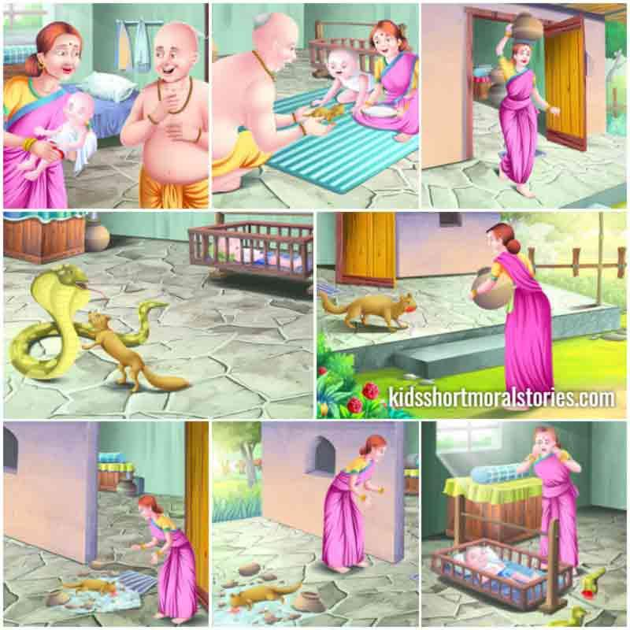
Story 10
5 MIN

Slide 56
Subtopic 5.1: Type topic & subtopic 5 in Google Scholar, identify papers from reputed publishers and having high citations (> 10)
Title of the paper | Empirical studies in reverse engineering: state of the art and future trends
Authors | Tonella, P., Torchiano, M., Du Bois, B. et al.
Journal Name | Empirical Software Engineering
Year | 2007
Volume (issue) | 12
Page numbers (XXX-YYY) | 1573-7616
Document identification Number (DOI), paste complete link | https://doi.org/10.1007/s10664-007-9037-5
Identified important sentences from the abstract (minimum 4-5) | Starting with the aim of modernizing legacy systems, often written in old programming languages, reverse engineering has extended its applicability to virtually every kind of software system. Moreover, the methods originally designed to recover a diagrammatic, high-level view of the target system have been extended to address several other problems faced by programmers when they need to understand and modify existing software. The authors’ position is that the next stage of development for this discipline will necessarily be based on empirical evaluation of methods. In fact, this evaluation is required to gain knowledge about the actual effects of applying a given approach, as well as to convince the end users of the positive cost–benefit trade offs. The contribution of this paper to the state of the art is a roadmap for the future research in the field, which includes: clarifying the scope of investigation, defining a reference taxonomy, and adopting a common framework for the execution of the experiments.
Rewrite the above sentences in your own words (minimum 4-5), avoid using words like I, WE, YOU, THEY, THEM), -stick to third person language, active voice, present tense

Slide 57
Subtopic 5.2: Type topic & subtopic 5 in Google Scholar, identify papers from reputed publishers and having high citations (> 10)
Title of the paper | On the generation of requirements specifications from software engineering models: A systematic literature review
Authors | Joaquín Nicolás, Ambrosio Toval,
Journal Name | Information and Software Technology,
Year | 2009,
Volume (issue) | Volume 51, Issue 9,
Page numbers (XXX-YYY) | 1291-1307
Document identification Number (DOI), paste complete link | https://doi.org/10.1016/j.infsof.2009.04.001.
Identified important sentences from the abstract (minimum 4-5) | System and software requirements documents play a crucial role in software engineering in that they must both communicate requirements to clients in an understandable manner and define requirements in precise detail for system developers. The benefits of both lists of textual requirements (usually written in natural language) and software engineering models (usually specified in graphical form) can be brought together by combining the two approaches in the specification of system and software requirements documents. If, moreover, textual requirements are generated from models in an automatic or closely monitored form, the effort of specifying those requirements is reduced and the completeness of the specification and the management of the requirements traceability are improved. This paper presents a systematic review of the literature related to the generation of textual requirements specifications from software engineering models. These requirements lists both make the validation of requirements by clients easier and clarify the size of the project and the actual state of the requirements development. The study of the proposals to combine business (system) or software models and textual requirements, thereby, becomes relevant.
Rewrite the above sentences in your own words (minimum 4-5), avoid using words like I, WE, YOU, THEY, THEM), -stick to third person language, active voice, present tense

Slide 58
Subtopic 5.3: Type topic & subtopic 5 in Google Scholar, identify papers from reputed publishers and having high citations (> 10)
Title of the paper | Replication of empirical studies in software engineering research: a systematic mapping study
Authors | da Silva, F.Q.B., Suassuna, M., França, A.C.C. et al.
Journal Name | Empirical Software Engineering
Year | 2014
Volume (issue) | 19
Page numbers (XXX-YYY) | 1573-7616
Document identification Number (DOI), paste complete link | https://doi.org/10.1007/s10664-012-9227-7
Identified important sentences from the abstract (minimum 4-5) | In this article, we present a systematic mapping study of replications in software engineering. The goal is to plot the landscape of current published replications of empirical studies in software engineering research. We applied the systematic review method to search and select published articles, and to extract and synthesize data from the selected articles that reported replications. Our search retrieved more than 16,000 articles, from which we selected 96 articles, reporting 133 replications performed between 1994 and 2010, of 72 original studies. Nearly 70 % of the replications were published after 2004 and 70 % of these studies were internal replications. The topics of software requirements, software construction, and software quality concentrated over 55 % of the replications, while software design, configuration management, and software tools and methods were the topics with the smallest number of replications. We conclude that the number of replications has grown in the last few years, but the absolute number of replications is still small, in particular considering the breadth of topics in software engineering. We still need incentives to perform external replications, better standards to report empirical studies and their replications, and collaborative research agendas that could speed up development and publication of replications.
Rewrite the above sentences in your own words (minimum 4-5), avoid using words like I, WE, YOU, THEY, THEM), -stick to third person language, active voice, present tense

Slide 59
Subtopic 5.4: Type topic & subtopic 5 in Google Scholar, identify papers from reputed publishers and having high citations (> 10)
Title of the paper | Identifying, categorizing and mitigating threats to validity in software engineering secondary studies
Authors | Apostolos Ampatzoglou, Stamatia Bibi, Paris Avgeriou, Marijn Verbeek, Alexander Chatzigeorgiou
Journal Name | Information and Software Technology,
Year | 2019,
Volume (issue) | 106
Page numbers (XXX-YYY) | 201-230
Document identification Number (DOI), paste complete link | https://doi.org/10.1016/j.infsof.2018.10.006.
Identified important sentences from the abstract (minimum 4-5) | Secondary studies are vulnerable to threats to validity. Although, mitigating these threats is crucial for the credibility of these studies, we currently lack a systematic approach to identify, categorize and mitigate threats to validity for secondary studies. Our results suggest that in recent years, secondary studies are more likely to report their threats to validity. However, the presentation of such threats is rather ad hoc, e.g., the same threat may be presented with a different name, or under a different category. To alleviate this problem, we propose a classification schema for reporting threats to validity and possible mitigation actions. Both the classification of threats and the associated mitigation actions have been validated by an empirical study, i.e., Delphi rounds with experts.
Rewrite the above sentences in your own words (minimum 4-5), avoid using words like I, WE, YOU, THEY, THEM), -stick to third person language, active voice, present tense

Slide 60
Subtopic 5.5: Type topic & subtopic 5 in Google Scholar, identify papers from reputed publishers and having high citations (> 10)
Title of the paper | Kanban in software engineering: A systematic mapping study
Authors | Muhammad Ovais Ahmad, Denis Dennehy, Kieran Conboy, Markku Oivo,
Journal Name | Journal of Systems and Software,
Year | 2018
Volume (issue) | 137
Page numbers (XXX-YYY) | 96-113
Document identification Number (DOI), paste complete link | https://doi.org/10.1016/j.jss.2017.11.045.
Identified important sentences from the abstract (minimum 4-5) | Following a well-established track record of success in other domains such as manufacturing, Kanban is increasingly used to achieve continuous development and delivery of value in the software industry. However, while research on Kanban in software is growing, these articles are largely descriptive, and there is limited rigorous research on its application and with little cohesive building of cumulative knowledge. As a result, it is extremely difficult to determine the true value of Kanban in software engineering. This study investigates the scientific evidence to date regarding Kanban by conducting a systematic mapping of Kanban literature in software engineering between 2006 and 2016. The search strategy resulted in 382 studies, of which 23 were identified as primary papers relevant to this research. This study is unique as it compares the findings of these primary papers with insights from a review of 23 Kanban experience reports during the same period. This study makes four important contributions, (i) a state-of-the-art of Kanban research is provided, (ii) the reported benefits and challenges are identified in both the primary papers and experience reports, (iii) recommended practices from both the primary papers and experience reports are listed and (iv) opportunities for future Kanban research are identified.
Rewrite the above sentences in your own words (minimum 4-5), avoid using words like I, WE, YOU, THEY, THEM), -stick to third person language, active voice, present tense

Slide 61
75% of your original review article is complete
Very good, really impressed, keep going

Slide 62

STORY 11:
NAGARJUNA SAGAR DAM
5 MIN

Slide 63
Acknowledgements
This research is funded by student research grant from RV University through Technical Writing course.

Slide 64
Writing Conclusion (one important futuristic sentence (written by you) from Field, Domain, Area, Subtopic 1 (1.1 to 1.5, any one sentence), same way one sentence from Subtopic 2-5
Conclusion:

Slide 65
Writing Abstract (one important futuristic sentence (written by you) from Field, Domain, Area, Subtopic 1 (1.1 to 1.5, any one sentence), same way one sentence from Subtopic 2-5
Abstract:

Slide 66
80% of your original review article is complete
Very good, really impressed, keep going
Assignment 7 is Complete

Slide 67





Story 12: Chinese Girl story
10 MIN

Slide 68
REMAINING 20% of the review paper IS TRANSFERRING YOUR ORIGINAL RESEARCH CONTENT TO MICROSOFT WORD AND REALIZING PAPER IN AN IEEE FORMAT
TAKE A MOMENT TO APPRECIATE YOUR HARD WORK & COMMITMENT, Let’s FINISH this ORIGINAL ARTICLE!
The IEEE Formatted Journal paper with minimal Plagiarism carries 20 Marks
VIVA on the research paper carries 10 Marks

Slide 69
Title of the paper
Author
Affiliation
Abstract
Background (Field, domain, area, topic)
Sub topic 1
Sub topic 2
Subtopic 3
Sub topic 4
Sub topic 5
Conclusion
Acknowledgement
References

Slide 70
Day 4
This ppt file to Microsoft Word (Hands on, IEEE format ready)
SCOPUS Indexing
Journal vs Conferences
Plagiarism
Open Access Vs Predatory
Additional Honors Credit (+1) for a SCOPUS Publication- What you have to do?

Slide 71
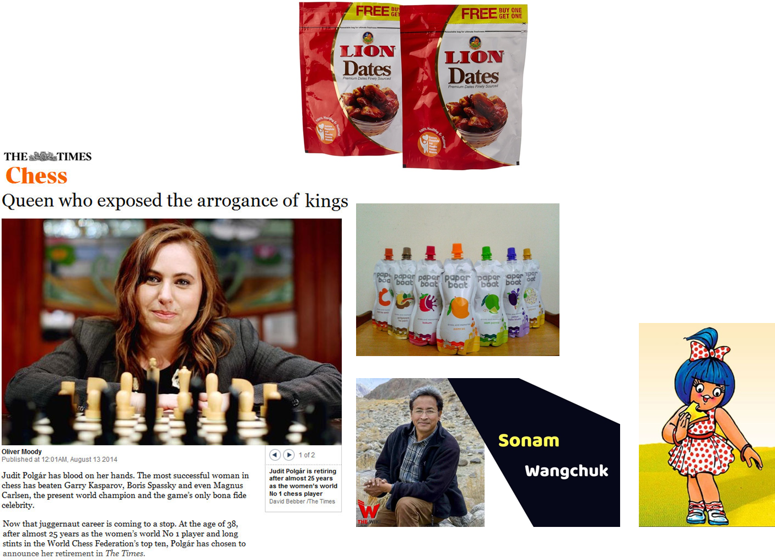
Day 4: Stories

Slide 72
Journal Indexing
Scopus
Web of Science
Recommended
A bit higher rated
Most SCOPUS listed journals are considered to be repued
High Impact factor

Slide 73
Selection of Journals
SCOPUS Q1
SCOPUS Q2/3
SCOPUS Q4
SCOPUS Conference Proceedings
Elsewhere, not much value

Slide 74
Clarivate Impact Factor of Journal
>5
Q2
>1
>4
>2
Q3
Q1
>3
<1, Q4

Slide 75
Clarivate Impact factor of Journals
https://en.wikipedia.org/wiki/Impact_factor

Slide 76
What I advise
Publish always in UGC CARE LIST OR SCOPUS Journals
Say You start from a paid journal, move up the ladder
Scopus Q4 & Q3
Scopus Q2
Scopus Q1

Slide 77
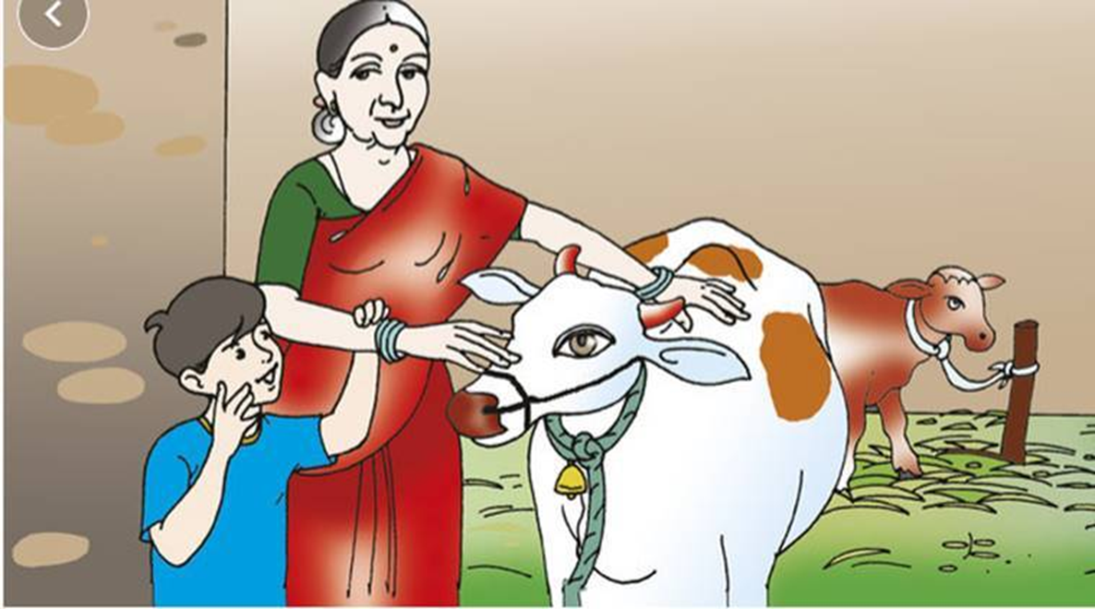
Importance of ethics- Villagers pour milk
If everyone cheats, who will do the real work?

Slide 78
Citation of Published Material
Always acknowledge the source or express it on your own, in such a way that it cannot be viewed as plagiarized

Slide 79
Ethical Issues Related to Publishing
Any thing which is taken without consent is stealing

Slide 80
Plagiarism and Self-Plagiarism
Lifting paragraphs from others or from your own prior publications

Slide 81
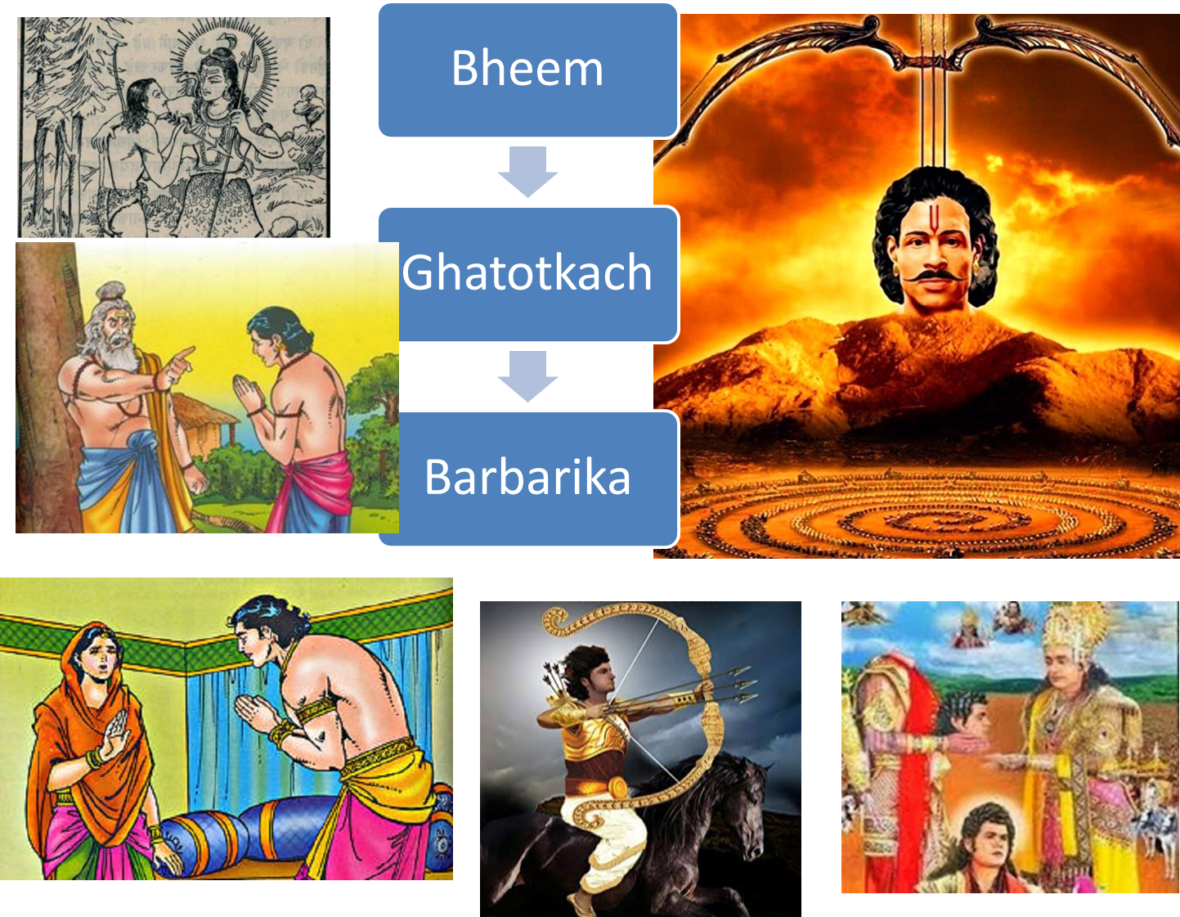
With Great Power comes- Great responsibility

Slide 82
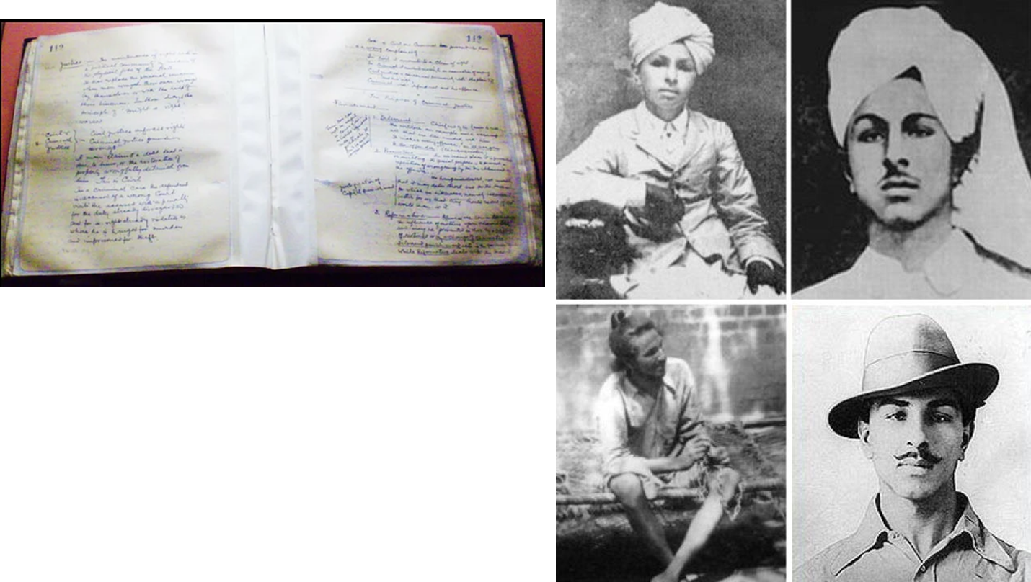
Truth will eventually come out!
PRISON HUNGER STRIKE

